Slide 1
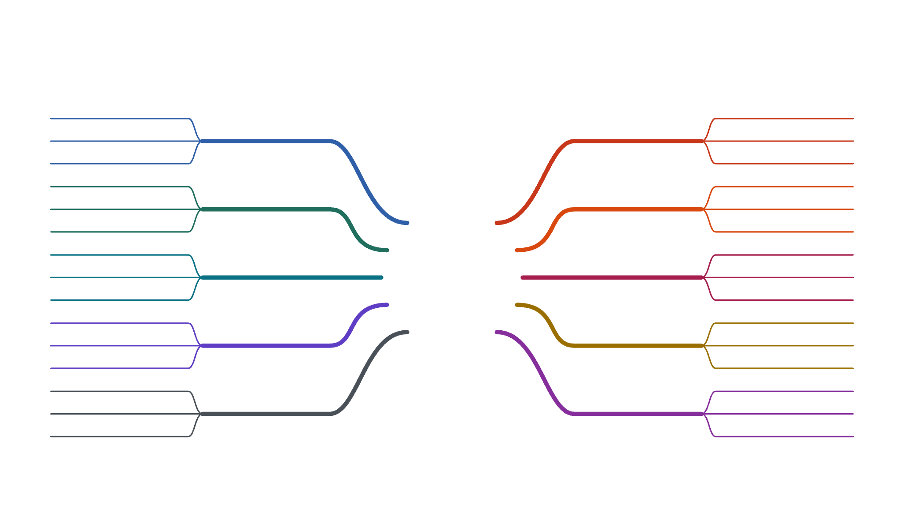
The RTOS mind map
RECAP · THE COMPLETE PICTURE
on time > fast
queue
hard · firm · soft
Why an RTOS ✓
Communication
mailbox
determinism
shared memory
kernel = boss
race condition
monolithic vs micro
OS basics ✓
Synchronization
mutex · semaphore
normal OS vs RTOS
deadlock
process vs thread
RTOS
ISR → task
task states
Tasks ✓
Interrupts
binary semaphore
multitasking
on time,
every time
device drivers
preemption
FCFS · SJF
golden rule
Scheduling ✓
Numericals
Round Robin
context switch
RMS · EDF
ESP32 + MPU-6050
timing · size
I²C wiring
Hardware ✓
Choosing RTOS
cost · safety
live tilt data
FreeRTOS · QNX
← DAY 1 ✓
DAY 2 →
Notes:
THE COMPLETE PICTURE OF RTOS on one page. LEFT, in cool colours with ticks: everything from Day 1. RIGHT, in warm colours: everything we do today. The ring around RTOS is half blue (yesterday), half orange (today). RECAP THE LEFT SIDE (about 8 minutes). Point at each branch, ask one question, let the room answer first: Why an RTOS: “Fast or on time?” On time: an RTOS makes sure the most urgent job runs on time, every time. “Airbag, video call, Spotify?” Hard (late = harm), firm (late = useless), soft (late = annoying). Determinism = the same timing every time. OS basics: “Who is the boss of the hardware?” The kernel. “A driver crashes: Linux or QNX, which one goes completely down?” Linux, a monolithic kernel; QNX is a microkernel, the driver just restarts. A normal OS is fair and fast on average; an RTOS guarantees the worst case. Tasks: “Process or thread, which one shares memory?” Thread; a FreeRTOS task is like a thread. States: Ready, Running, Blocked. One core taking turns = multitasking. Scheduling: “The sensor wakes while the LED task runs. What happens?” The LED task is paused: preemption. The golden rule: the most important ready task always gets the CPU. Pausing and resuming = context switch. Hardware: we wired the ESP32 to the MPU-6050 over I²C and saw live tilt data. THEN THE RIGHT SIDE, as today’s plan, top to bottom: how tasks pass data (communication), how they share without breaking things (synchronization), how hardware gets instant attention (interrupts, drivers), the numericals, and how to choose an RTOS for a real product. Say: “We won’t learn the right side from a list. We’ll build one small program, and each branch will grow exactly when we need it.” Come back to this slide at the very end: the whole map is done.

Slide 2




12 lines. That’s the whole RTOS toolbox.
MEET TODAY’S SYNTAX
Workers
Steps 2–3 · tasks
The key
Step 4 · mutex
xTaskCreate(…)
create a task
xSemaphoreCreateMutex()
make the key
vTaskDelay(…)
sleep a while
xSemaphoreTake(…)
take it
vTaskDelayUntil(…)
wake on the beat
xSemaphoreGive(…)
give it back
The rail
Step 5 · queue
The bell
Step 6 · interrupt
xQueueCreate(…)
build the rail
attachInterrupt(…)
connect the doorbell
xQueueSend(…)
drop a copy on it
xSemaphoreCreateBinary()
make the bell
xQueueReceive(…)
pick up the next
xSemaphoreGiveFromISR(…)
ring it
Easy to type. The real skill is knowing WHEN to use each one.
Notes:
Show this right after the recap, for about one minute. Don’t teach it yet. Say: “Hi everyone, this is the syntax we’re going to learn today. Twelve lines, in four groups. That’s ALL the RTOS code we’ll use, and by the end of the coding part you’ll have written every one of them yourself.” WORKERS (Steps 2–3): xTaskCreate creates a task, a worker with its own job; vTaskDelay puts it to sleep for a while (0% CPU); vTaskDelayUntil wakes it exactly on a fixed beat. THE KEY (Step 4): xSemaphoreCreateMutex makes a mutex, the one key; xSemaphoreTake takes it (waits if someone else has it); xSemaphoreGive gives it back. THE RAIL (Step 5): xQueueCreate builds a queue, an order rail between tasks; xQueueSend drops a copy on it; xQueueReceive picks up the next one (sleeps if the rail is empty). THE BELL (Step 6): attachInterrupt connects the BOOT button to a tiny function, the ISR; xSemaphoreCreateBinary makes a bell (a binary semaphore); xSemaphoreGiveFromISR rings it from inside the ISR. Bottom line: the syntax is easy; the skill is knowing WHEN you need each one. That’s what the next hour is about. Come back to this slide after Step 6: all twelve used.

Slide 3
Blink & Count
OUR MINI PROJECT · BOARD ONLY, NO WIRING
Three small jobs. Easy alone. Hard together.
JOB 1
JOB 2
JOB 3
Count
Blink
Click
1, 2, 3… every 100 ms
LED on 0.5 s, off 0.5 s
press BOOT → “CLICK!”
urgent
not urgent
must be instant
Every step:
WANT
→
BUILD
→
CODE
→
RUN
→
PROBLEM
→
RTOS FIX
Notes:
Introduce the mini project. Everyone needs only their ESP32 and the USB cable. No sensor, no wires, so nothing can go wrong with the hardware. Three jobs, each easy on its own: count up every 100 ms and print it, blink the on-board LED, and print CLICK! when the BOOT button is pressed. The catch: one CPU has to do all three, on time. That is exactly the problem an RTOS solves. BOTTOM ROW, how every step today works, always in this order: what we WANT, what we BUILD, the CODE (read line by line), we RUN it, we find the PROBLEM (stated in one sentence), and the RTOS FIX for it. The fix of one step is where the next step starts. The same row sits at the top of every step slide, so you always know where we are. Tell them: “A real gaming mouse has the same three jobs: read the sensor (urgent, like Count), show a status light (like Blink), and react to a click (like Click). At the end of today you’ll see that.”

Slide 4
STEP 1
WANT
→
BUILD
→
CODE
→
RUN
→
PROBLEM
→
RTOS FIX
WE WANT
WE BUILD
Count every 100 ms, blink the LED, catch every click
All three jobs, one after another, in one loop()
int count = 0;
1
setup() runs once, when the board starts
void setup() { // 1
Serial.begin(115200);
2
Pin 2 = the LED, pin 0 = the BOOT button
pinMode(2, OUTPUT); // 2
pinMode(0, INPUT_PULLUP);
3
loop() runs top to bottom, then again, forever
}
void loop() { // 3
digitalWrite(2, HIGH); delay(500); // 4
4
LED on / off. delay(500) = stand still 0.5 s
digitalWrite(2, LOW); delay(500);
count++; // 5
5
count++ = add 1, then print it
Serial.println(count);
if (digitalRead(0) == LOW) // 6
6
if BOOT is pressed right now, print CLICK!
Serial.println("CLICK!");
}
Guess: how often does count print?
Notes:
STEP 1 IS ALSO OUR “HOW TO READ ARDUINO CODE” LESSON (about 6 minutes). Don’t assume anyone has coded before. Read the code top to bottom with the numbers on the right. int count = 0; makes a box called count that holds a whole number, starting at 0. 1. setup() { … } runs ONCE when the board powers on or resets, like waking up. Serial.begin(115200) opens the Serial Monitor so the board can print to the laptop. 2. pinMode tells the board how each pin is used: pin 2 is the on-board LED (an OUTPUT, we switch it), pin 0 is the BOOT button (an INPUT; INPUT_PULLUP means it reads HIGH normally and LOW while pressed). 3. loop() { … } runs from top to bottom, and when it reaches the end it starts again from the top, forever. Like a to-do list repeated all day. 4. digitalWrite(2, HIGH) switches the LED on, LOW switches it off. delay(500) means stand still for 500 milliseconds and do NOTHING else. 5. count++ adds 1 to count. Serial.println(count) prints it on a new line. 6. if (…) only runs the next line when the condition is true: is the BOOT button pressed at this exact moment? Small rules: every line ends with ; { } wrap a block of steps // starts a note for humans. GUESS before running: “We want count every 100 ms. How often will it really print? And will a very quick BOOT tap always print CLICK?” Collect 3–4 answers, then run it.

Slide 5
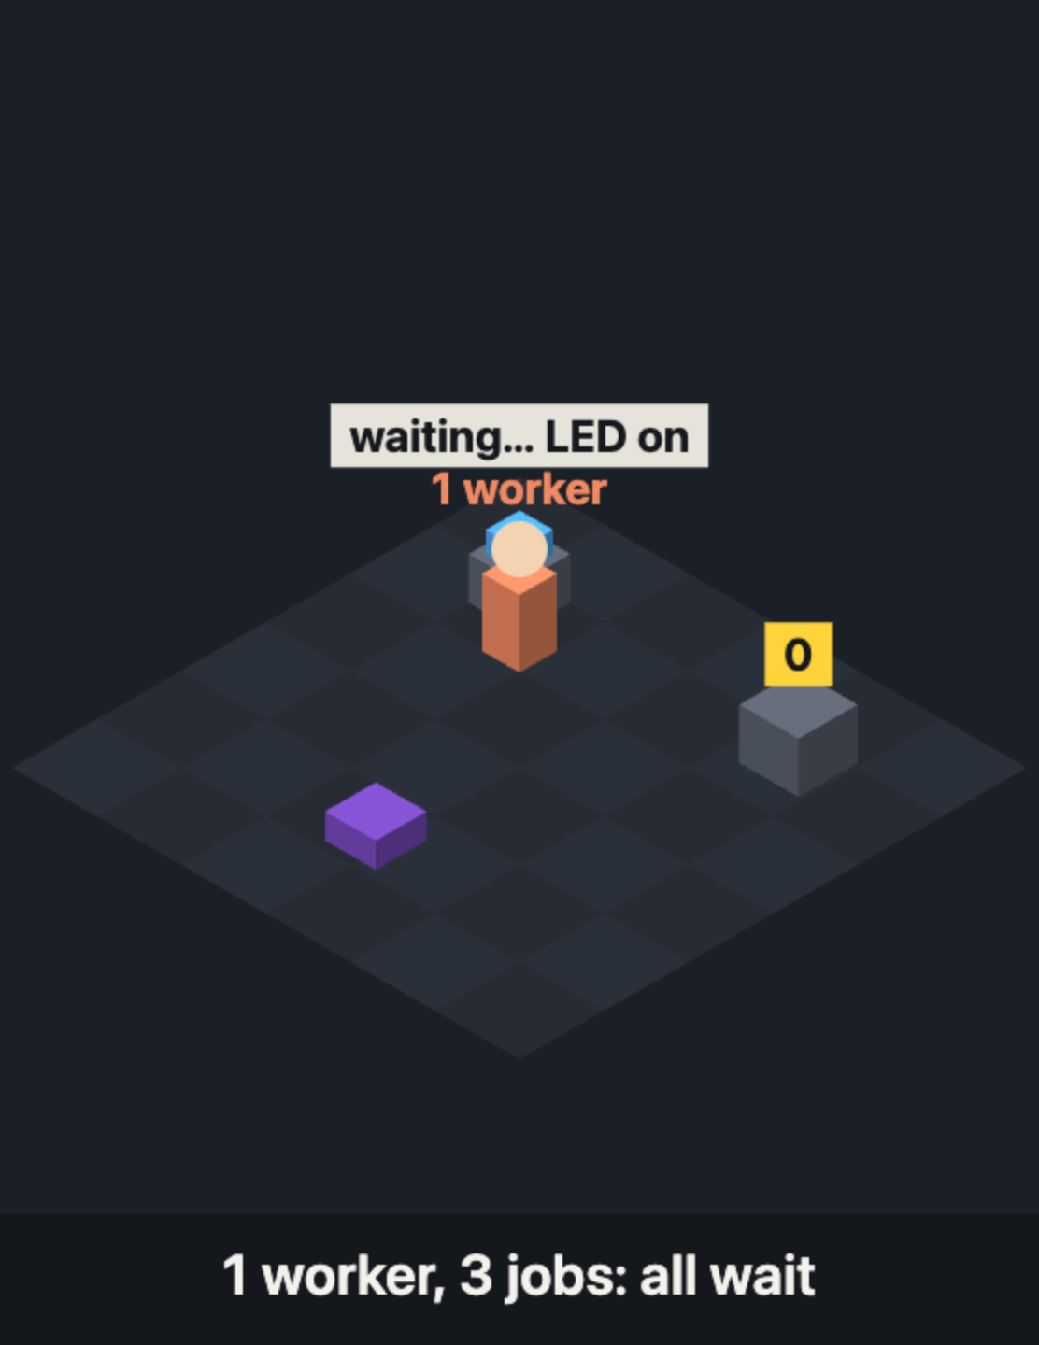
STEP 1
WANT
→
BUILD
→
CODE
→
RUN
→
PROBLEM
→
RTOS FIX
WHAT HAPPENS
1
…1 second…
2
…1 second…
3
10× too slow
Quick BOOT taps:
missed
checked only once a second
THE PROBLEM
One slow job makes every other job wait.
THE RTOS FIX
Give each job its own worker, and let the RTOS decide who works.
xTaskCreate → Step 2
Exam words:
super-loop
polling
Notes:
STEP 1, RUN IT (about 4 minutes). Run Step 1 on the projector. Count prints 1, 2, 3… once per second. Ask a volunteer to tap BOOT quickly a few times: most taps never print CLICK!. WHY: one round of loop() is 500 ms LED on + 500 ms LED off, and only then a tiny moment to count and to check the button. The worker stands still inside delay() for almost the whole second. A tap that starts and ends during the delays is never seen. THE PROBLEM in one sentence: one slow job makes every other job wait. NAME IT: this design is a SUPER-LOOP (one big loop doing every job in turn). Checking a button by asking “is it pressed right now?” is called POLLING. THE RTOS FIX: give each job its own worker (a task) and let the RTOS, the manager, decide who works when. Someone may say “use millis()”: that helps small programs, but every job still waits for the slowest one and nothing can be more important than anything else. Transition: “Let’s hire our first worker.”

Slide 6
STEP 2
WANT
→
BUILD
→
CODE
→
RUN
→
PROBLEM
→
RTOS FIX
WE WANT
WE BUILD
Count on time, even while the LED blinks
Give Count its own worker: our first task
int count = 0;
1
A task is a normal function…
void countTask(void *p) { // 1
2
…that loops forever
for (;;) { // 2
count++;
3
Sleep 100 ms. Asleep = 0% CPU
Serial.println(count);
vTaskDelay(pdMS_TO_TICKS(100)); // 3
4
Hire the worker: job, name, notepad size, priority
}
}
void setup() {
5
loop() still blinks, same as before
Serial.begin(115200); pinMode(2, OUTPUT);
Guess: is count on time now?
xTaskCreate(countTask, "count", 2048, NULL, 1, NULL); // 4
}
void loop() { /* blink, same as Step 1 */ } // 5
Notes:
STEP 2, THE CODE (about 5 minutes). The highlighted lines are new; everything else is from Step 1. 1. countTask is a completely normal C function. What makes it a task is how we use it. 2. for (;;) means “loop forever”. A task never finishes and never returns. 3. vTaskDelay(pdMS_TO_TICKS(100)): “put me to sleep for 100 ms”. pdMS_TO_TICKS turns milliseconds into RTOS ticks (on the ESP32 one tick is 1 ms). While asleep the task uses zero CPU. 4. xTaskCreate hands the function to the RTOS: run this as a separate worker. Its six values, like hiring a worker: countTask = the job description; "count" = a name badge (for debugging); 2048 = stack size in bytes, the worker’s private notepad for local variables; NULL = nothing passed in; 1 = priority (bigger number = more important; 0 is the idle task); NULL = no handle needed (a handle lets you control the task later). 5. loop() is unchanged from Step 1: it still blinks with delay(500) twice. Guess before running: “loop() still waits 1 second per round. Will count be on time?” Many will say no. Then run it: count prints every 100 ms AND the LED blinks. The surprise is explained on the next slide.

Slide 7

STEP 2
WANT
→
BUILD
→
CODE
→
RUN
→
PROBLEM
→
RTOS FIX
WHAT HAPPENS
Count:
1
2
3
4
every 100 ms
· LED blinks
both on time!
Why? Asleep = 0% CPU. And loop() is a task too: its delay() is really vTaskDelay().
THE PROBLEM
It only works because every task sleeps. A heavy job that never sleeps would make Count late.
THE RTOS FIX
Give every task a priority: the urgent one always goes first.
priority numbers + vTaskDelayUntil → Step 3
Exam words:
task
Ready · Running · Blocked
multitasking
multiprocessing
Notes:
STEP 2, RUN IT (about 5 minutes). Run Step 2: count prints every 100 ms AND the LED still blinks once a second. Ask: “loop() still has delay(500). Why isn’t Count stuck behind it?” WHY IT WORKS: a task is READY when it wants the CPU, RUNNING when it has it, BLOCKED when it is asleep or waiting. countTask runs for a moment, calls vTaskDelay and becomes Blocked, using no CPU. 100 ms later the RTOS makes it Ready again and it runs. (A fourth state, SUSPENDED, means switched off with vTaskSuspend.) SECRETS: loop() is itself a task (loopTask, priority 1) that the ESP32 creates for you, and on the ESP32 delay() is really vTaskDelay(). While loop() waits, it is asleep, and the RTOS gives the CPU to countTask. You’ve used an RTOS since your first Arduino sketch. EXAM WORDS: a TASK (like a thread: its own stack, shared memory). MULTITASKING = one core switching between tasks so fast they look simultaneous. MULTIPROCESSING = several cores really at the same time; the ESP32 has two. THE PROBLEM: this only works because everyone sleeps. Real jobs can be heavy. What if Blink keeps the CPU busy? THE RTOS FIX: priorities. Next step.

Slide 8
STEP 3
WANT
→
BUILD
→
CODE
→
RUN
→
PROBLEM
→
RTOS FIX
WE WANT
WE BUILD
Count on time, even when Blink does heavy work
Blink busy for 400 ms, and a priority for each task
#define COUNT_PRIORITY 3 // 1
1
Two priorities to play with
#define BLINK_PRIORITY 1
2
Print the time too
void countTask(void *p) {
TickType_t last = xTaskGetTickCount();
3
Wake on every 100 ms bell
for (;;) {
count++;
4
Busy 400 ms: never sleeps
Serial.printf("count %d at %lu ms\n", count, millis()); // 2
vTaskDelayUntil(&last, pdMS_TO_TICKS(100)); // 3
Guess: blink hogs the CPU for 400 ms. Is count still on time?
}
}
void blinkTask(void *p) {
for (;;) {
digitalWrite(2, HIGH); busyWork(400); // 4
digitalWrite(2, LOW); vTaskDelay(pdMS_TO_TICKS(500));
}
}
Notes:
STEP 3, THE CODE (about 5 minutes). Now the blink job is HEAVY: while the LED is on, it does 400 ms of busy work (busyWork is a loop that just burns time, like a real product doing maths). It does not sleep during that time. 1. Two #defines hold the priorities, so we can swap them easily. Count gets 3, blink gets 1. (Remember: bigger = more important.) 2. Count now prints the time in ms too, so we can see exactly when it runs. 3. vTaskDelayUntil(&last, 100 ms) means “wake me at the next 100 ms mark”, measured from the last wake-up, like a school bell that rings on the hour. vTaskDelay(100) would mean “100 ms from now”, and since printing takes a little time, it would slowly drift: 0, 101, 203… DelayUntil keeps the exact beat: 0, 100, 200. 4. blinkTask: LED on, 400 ms of busy work, LED off, then sleep 500 ms. In setup (not shown, it’s in the code document): both tasks are created with xTaskCreatePinnedToCore, which is xTaskCreate plus a 7th value, the core (we use core 1). loop() just deletes itself with vTaskDelete(NULL). Guess: “Blink is busy for 400 ms. Will count still print every 100 ms?” Then run it, first as written (A), then with the priorities swapped (B).

Slide 9
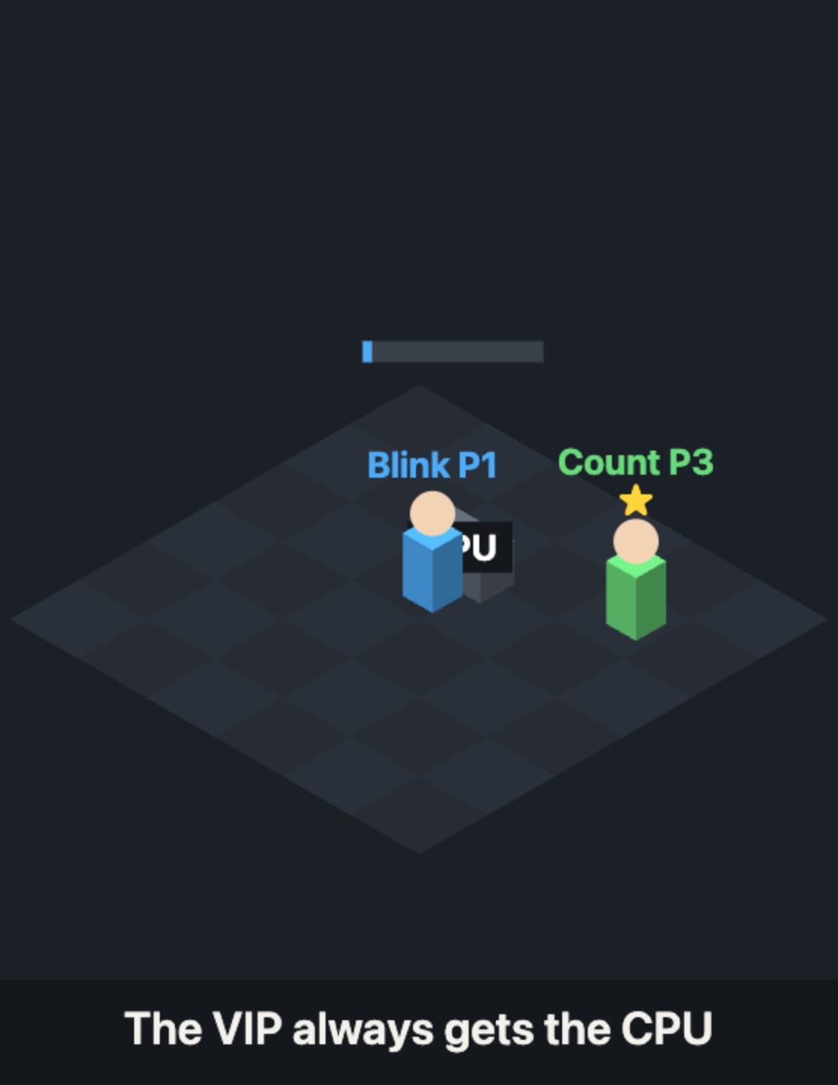
STEP 3
WANT
→
BUILD
→
CODE
→
RUN
→
PROBLEM
→
RTOS FIX
WHAT HAPPENS
A count 3, blink 1:
100
200
300
400
500
on the beat
B count 1, blink 3:
100
waits 400 ms
500
500
500
late, then a burst
THE PROBLEM
If the wrong task is more important, the urgent job runs late.
THE RTOS FIX
Give the urgent job the highest priority. The RTOS pauses everyone else for it.
the golden rule → now YOU be the scheduler
Exam words:
preemption
golden rule
context switch
jitter
Notes:
STEP 3, RUN IT TWICE (about 8 minutes). The numbers show the pattern; theirs will be similar. RUN A (count 3, blink 1): count prints at 100, 200, 300… exactly on the beat, even though Blink is busy for 400 ms and never sleeps. Ask: “So how did Count get the CPU?” NAME IT: PREEMPTION. Every 100 ms Count becomes ready, and because it is more important the RTOS pauses Blink mid-job, runs Count, then lets Blink continue exactly where it stopped. Analogy: breaking news cutting into any TV show. The pause itself is a CONTEXT SWITCH: the RTOS saves Blink’s place (registers) in its task control block (TCB) and loads Count’s, like a video-game save point. RUN B: swap the two #defines and upload again. Now Blink is more important and doesn’t sleep for 400 ms: Count waits, then catches up in a burst. That wobble in timing is JITTER. THE GOLDEN RULE: the highest-priority task that is ready always gets the CPU. Equal priorities take turns every 1 ms tick (round-robin). A high task that never sleeps would starve everyone (Step 7). Transition to the numericals: “The RTOS just decided who runs and when. Now YOU be the scheduler.”

Slide 10
One cook, three orders: who goes first?
NUMERICALS · NOW YOU BE THE SCHEDULER
The orders (time needed):
P1 = 10
P2 = 5
P3 = 8
all arrive at time 0
FCFS
SJF
Round Robin
First come, first served
Shortest job first
Everyone gets 4 minutes, then the next
Whoever reached the counter first, even with a big order
“Just one chai” orders go first
The cook takes turns, again and again
2 FORMULAS
Turnaround = finish time − arrival
Waiting = turnaround − time needed
Notes:
NUMERICALS, PART 1 (about 8 minutes). Bridge from Step 3: “The RTOS just decided who runs and when. Now YOU are the scheduler.” The analogy: the college canteen has ONE cook (the CPU) and three orders (processes) that all arrive at the same moment. P1 needs 10 minutes, P2 needs 5, P3 needs 8. HUMAN SCHEDULER GAME: three volunteers hold sheets with 10, 5 and 8. A chair is the CPU. For each rule, the class tells them who sits and for how long, and you draw the timeline on the board. FCFS (first come, first served): in order of arrival, P1, P2, P3. Simple, but the short orders wait behind the long one. SJF (shortest job first): the shortest order first: P2 (5), then P3 (8), then P1 (10). Gives the lowest average waiting time, but you must know the times in advance. ROUND ROBIN: everyone gets a fixed slice of time (the quantum, here 4), then goes to the back of the line. Fair: nobody waits too long for a first turn. (Also in the syllabus: PRIORITY scheduling, most important first, like the principal’s order jumping the line; its risk is starvation, fixed by aging. And SRTF, the preemptive version of SJF.) THE TWO FORMULAS: turnaround time = when it finishes minus when it arrived. Waiting time = turnaround minus the time it actually needed. Next slide: the full solution.

Slide 11
P1 = 10, P2 = 5, P3 = 8: three timelines
NUMERICALS · THE SOLUTION
FCFS
P1
P2
P3
avg waiting
8.33
0
10
15
23
avg turnaround 16.00
waits: P1 0 · P2 10 · P3 15
SJF
P2
P3
P1
avg waiting
6.00
0
5
13
23
avg turnaround 13.67
waits: P2 0 · P3 5 · P1 13
RR (q = 4)
P1
P2
P3
P1
P3
P1
avg waiting
12.67
0
4
8
12
16
17
21
23
avg turnaround 20.33
waits: P1 13 · P2 12 · P3 13
WINNER
SJF has the lowest wait (6.00). Round Robin is the fairest: everyone starts within 8.
Notes:
NUMERICALS, PART 2: THE FULL SOLUTION (about 12 minutes). Solve each row together on the board before revealing it. Each bar is drawn to scale; the numbers under the bars are the start times, ending at 23. FCFS: P1 runs 0–10, P2 10–15, P3 15–23. Finish times 10, 15, 23. Turnaround (finish − 0) = 10, 15, 23 → average 16.00. Waiting (turnaround − need) = 0, 10, 15 → average 25 ÷ 3 = 8.33. SJF: P2 0–5, P3 5–13, P1 13–23. Finish 5, 13, 23 → average turnaround 41 ÷ 3 = 13.67. Waiting P2 0, P3 5, P1 13 → average 18 ÷ 3 = 6.00. The lowest: SJF is provably best for average waiting time. ROUND ROBIN, quantum 4: P1 0–4, P2 4–8, P3 8–12, P1 12–16, P2 16–17 (only 1 left, done), P3 17–21 (done), P1 21–23 (done). Finish P1 23, P2 17, P3 21 → turnaround 23, 17, 21 → average 61 ÷ 3 = 20.33. Waiting = 23 − 10 = 13, 17 − 5 = 12, 21 − 8 = 13 → average 38 ÷ 3 = 12.67. Why is RR worse here? All the switching makes everyone finish later. But it is the fairest: each order gets its first turn by time 8 (response time). That is why real systems often use it for equal-priority tasks (FreeRTOS does exactly this every 1 ms tick). Exam tip: always draw the Gantt chart first, then write finish times under it, then compute.

Slide 12
Your turn: first correct team wins
NUMERICALS · TEAM RACE
P1 = 6
P2 = 3
P3 = 1
P4 = 4
all arrive at time 0
1 · FCFS
2 · SJF
3 · RR, q = 2
Draw the timeline
Shortest first
2 units each, in turns
FIND
Average waiting time and average turnaround time for each.
Notes:
TEAM RACE (about 10 minutes). Teams of 4. First team with all three correct wins. ANSWERS (don’t show them): FCFS: P1 0–6, P2 6–9, P3 9–10, P4 10–14. Finish 6, 9, 10, 14 → average turnaround 39 ÷ 4 = 9.75. Waiting 0, 6, 9, 10 → average 25 ÷ 4 = 6.25. SJF: P3 0–1, P2 1–4, P4 4–8, P1 8–14. Finish P1 14, P2 4, P3 1, P4 8 → average turnaround 27 ÷ 4 = 6.75. Waiting P1 8, P2 1, P3 0, P4 4 → average 13 ÷ 4 = 3.25. ROUND ROBIN, q = 2: P1 0–2, P2 2–4, P3 4–5 (done), P4 5–7, P1 7–9, P2 9–10 (done), P4 10–12 (done), P1 12–14 (done). Finish P1 14, P2 10, P3 5, P4 12 → average turnaround 41 ÷ 4 = 10.25. Waiting 14−6 = 8, 10−3 = 7, 5−1 = 4, 12−4 = 8 → average 27 ÷ 4 = 6.75. Same lesson as before: SJF gives the lowest waiting time (3.25), Round Robin is the fairest. If time allows, the real-time bonus: tasks (run time, period) = (1, 4), (2, 6), (3, 12). Utilization U = 1/4 + 2/6 + 3/12 = 0.833. Rate Monotonic guarantees deadlines if U ≤ 0.780 for 3 tasks, so the quick test can’t promise it; the exact check gives task 3 a response time of 10, within its period of 12, so it does work. EDF only needs U ≤ 1.

Slide 13
STEP 4
WANT
→
BUILD
→
CODE
→
RUN
→
PROBLEM
→
RTOS FIX
WE WANT
WE BUILD
Two workers add to ONE count: total 200,000
Two tasks on two cores, sharing one variable
volatile int count = 0;
1
The one key (a mutex)
SemaphoreHandle_t key; // 1
2
Add 1, 100,000 times
void adderTask(void *p) {
for (int i = 0; i < 100000; i++) { // 2
3
Take the key (wait if busy)
xSemaphoreTake(key, portMAX_DELAY); // 3
count++; // 4
4
Touch the shared data
xSemaphoreGive(key); // 5
}
5
Give it back
vTaskDelete(NULL); // this worker is done
6
Two workers, two cores
}
// in setup(): one worker on each core // 6
First run it WITHOUT lines 3 and 5. Total = 200,000?
key = xSemaphoreCreateMutex();
xTaskCreatePinnedToCore(adderTask, "A", 2048, NULL, 1, NULL, 0);
xTaskCreatePinnedToCore(adderTask, "B", 2048, NULL, 1, NULL, 1);
Notes:
STEP 4, THE CODE (about 5 minutes). New situation: two tasks share ONE variable. Two copies of adderTask run at the same time, one on each of the ESP32’s two cores (the last value, 0 and 1). Each adds 1 to count, 100,000 times. So the total should be 200,000. In the real program (Step 4 in the code document) the highlighted take/give lines only run when you type m. Typing r runs it without them. DEMO ORDER: first type r (no key). Before that, ask: “Total = 200,000?” Most say yes. It’s less, and different every time. Then explain on the next slide (IRCTC), and only then type m (with the key): exactly 200,000. Line by line: 1. SemaphoreHandle_t key: the mutex, our one key. Created in setup with xSemaphoreCreateMutex(). 2. The loop: 100,000 additions. 3. xSemaphoreTake(key, portMAX_DELAY): take the key. If the other worker has it, wait (portMAX_DELAY = wait as long as needed). While waiting, the task is Blocked. 4. count++: the dangerous line, touching shared data. 5. xSemaphoreGive(key): put the key back so the other worker can go. 6. One worker per core. volatile tells the compiler: this variable can change behind your back, always read it fresh.

Slide 14
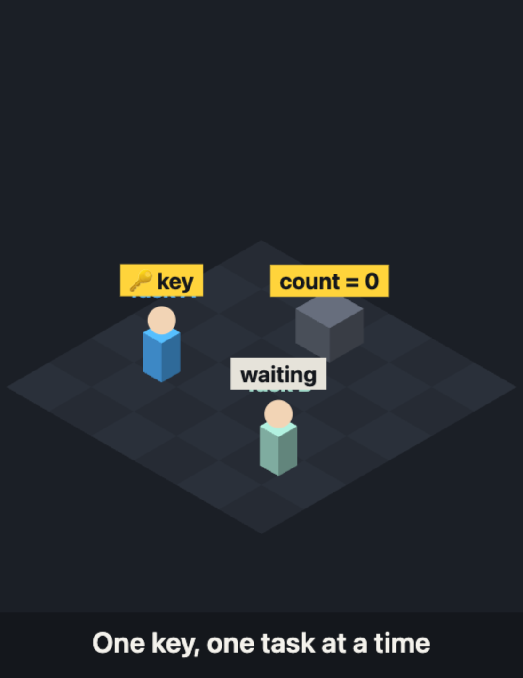
STEP 4
WANT
→
BUILD
→
CODE
→
RUN
→
PROBLEM
→
RTOS FIX
WHAT HAPPENS
Type r (no key):
137,452
151,908
wrong, different every time
Type m (with key):
200,000
200,000
always right
THE PROBLEM
Two tasks changing one variable at the same time lose updates.
THE RTOS FIX
Lock the shared part with a mutex: one key, one task at a time.
xSemaphoreTake(key) … xSemaphoreGive(key)
Exam words:
race condition
critical section
mutex
Notes:
STEP 4, RUN IT (about 10 minutes). Example numbers on the slide; theirs will differ every run, which is the point. 1. Type r: no protection. Less than 200,000, different each time. Let them guess why. 2. ROLEPLAY, the IRCTC last seat: write “Seats left: 1”. Two volunteers are two Tatkal bookings, slow motion: A reads 1, B reads 1, A books and writes 0, B books and writes 0. Two tickets, one seat. 3. CONNECT: count++ is really three steps: read, add 1, write back. If both workers read the same old value, one addition is lost. THE PROBLEM: two tasks changing one variable at the same time lose updates. NAME IT: a RACE CONDITION (the result depends on who gets there first). The lines that touch shared data are the CRITICAL SECTION. THE RTOS FIX: redo the roleplay with one marker: only the person holding it may touch the board. That is a MUTEX. Type m: exactly 200,000, a little slower (sometimes a worker waits for the key). Keep the locked part as short as possible. Next slide: the exam table, mutex vs semaphores.

Slide 15
Mutex or semaphore?
SIDE BY SIDE · TASK SYNCHRONIZATION
 | Mutex | Binary semaphore | Counting semaphore
Like… | the one key to the lab | a pressure-cooker whistle | 3 parking spots + a counter
Job | protect shared data | signal “it happened” | share N identical things
Who gives it back | only the task that took it | anyone, often an interrupt | anyone
Our project | count in Step 4 | the BOOT click (Step 6) | a pool of buffers
IN ONE LINE
A mutex is for locking. A semaphore is for signalling or counting.
Notes:
EXAM CHEAT SHEET for synchronization (about 4 minutes). A classic exam question: “differentiate mutex and semaphore.” Read row by row. MUTEX: like the one key to the lab. Its only job is protecting shared data. Only the task that took it may give it back (it has an OWNER). In FreeRTOS a mutex also has priority inheritance, which we’ll need in a few minutes. BINARY SEMAPHORE: like a pressure-cooker whistle. It carries no data, it just says “it happened”. Anyone can give it, very often an interrupt, and a waiting task wakes up. We use one for the BOOT click in Step 6. COUNTING SEMAPHORE: like a parking lot with 3 spots and a counter at the gate. It lets up to N tasks use N identical resources; the counter goes down when one is taken and up when it’s returned. Give them 30 seconds to photograph it.

Slide 16
STEP 5
WANT
→
BUILD
→
CODE
→
RUN
→
PROBLEM
→
RTOS FIX
WE WANT
WE BUILD
Share numbers without locks and waiting
Count sends copies to Print through a queue
QueueHandle_t numbers; // 1
1
The queue: an order rail between tasks
void countTask(void *p) {
int count = 0; // 2
2
count is private now
for (;;) {
count++;
3
Send a copy onto the rail
xQueueSend(numbers, &count, 0); // 3
vTaskDelay(pdMS_TO_TICKS(100));
4
Wait for the next one: asleep until it arrives
}
}
void printTask(void *p) {
Nothing is shared, so nothing can break.
int got;
for (;;) {
xQueueReceive(numbers, &got, portMAX_DELAY); // 4
Serial.printf("got %d\n", got);
}
}
Notes:
STEP 5, THE CODE (about 5 minutes). Step 4 fixed sharing with a lock. Step 5 shows the other way: don’t share at all, SEND a copy. 1. QueueHandle_t numbers: a queue, like the order rail in a restaurant kitchen. Created in setup with xQueueCreate(10, sizeof(int)): room for 10 numbers. 2. count now lives inside countTask. Nobody else can touch it. 3. xQueueSend(numbers, &count, 0): put a COPY of count onto the rail. The 0 means “if the rail is full, don’t wait, just skip it”. 4. xQueueReceive(numbers, &got, portMAX_DELAY): take the next number off the rail. If the rail is empty, printTask sleeps (Blocked, 0% CPU) until a number arrives. No checking, no wasted time. Priorities in setup: count 3, print 2, blink 1. Run it: “got 1, got 2…” every 100 ms while the LED blinks. This pattern is called PRODUCER → QUEUE → CONSUMER. Our Gaming Mouse uses exactly this: sensorTask produces readings, cursorTask consumes them.

Slide 17
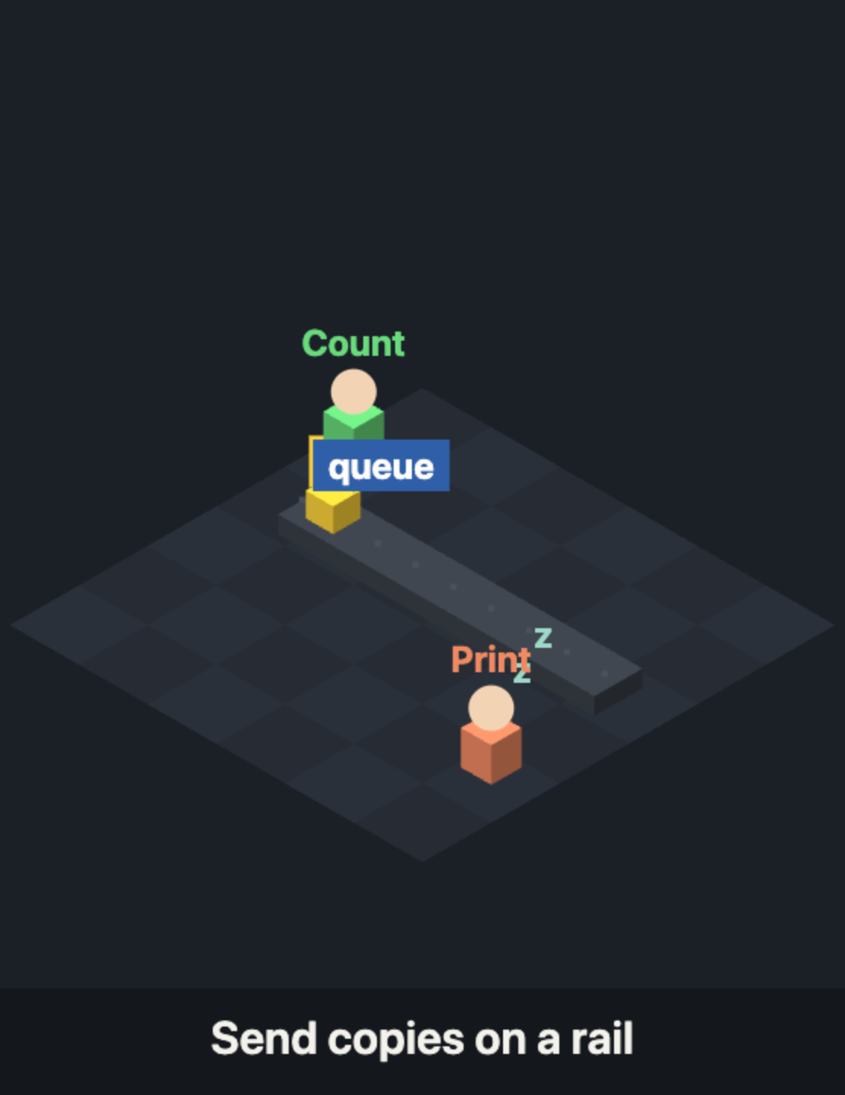
STEP 5
WANT
→
BUILD
→
CODE
→
RUN
→
PROBLEM
→
RTOS FIX
WHAT HAPPENS
Print shows:
got 1
got 2
got 3
every 100 ms
nothing shared, nothing locked
printTask sleeps until a number arrives: no checking, no waiting for a key.
THE PROBLEM
Shared data needs a lock, and a lock makes tasks wait for each other.
THE RTOS FIX
Don’t share, send: a queue passes copies from one task to another.
xQueueSend → xQueueReceive
Exam words:
task communication
queue
producer → consumer
Notes:
STEP 5, RUN IT (about 6 minutes). Run Step 5: “got 1, got 2…” every 100 ms while the LED blinks. THE PROBLEM it solves: in Step 4 we protected shared data with a key, but a key means tasks sometimes wait for each other. Often the cleaner design is to not share at all. THE RTOS FIX: a QUEUE, like a Swiggy order rail. countTask drops a COPY of each number on the rail (xQueueSend); printTask takes them off in order (xQueueReceive) and simply sleeps when the rail is empty. Nothing is shared, so nothing needs a lock. NAME IT: this is TASK COMMUNICATION, and this pattern is PRODUCER → QUEUE → CONSUMER. The Gaming Mouse uses exactly this: sensorTask produces readings, cursorTask consumes them. Next slide: the six ways tasks talk, for the exam.

Slide 18
Six ways tasks talk
STEP 5 · NAME IT · TASK COMMUNICATION
Way | Like… | Use it when
Shared memory | a whiteboard everyone writes on | fast, but needs a lock
Queue | a Swiggy order rail | every message matters
Mailbox | a cricket scoreboard | only the latest value matters
Pipe | a water pipe of bytes | a stream: UART, audio
Signal | a pressure-cooker whistle | “it happened”, no data
Socket / RPC | a phone call | between two devices
Notes:
EXAM CHEAT SHEET for task communication (about 4 minutes). The syllabus calls this “task communication”. There are two families: shared memory (tasks read and write the same data) and message passing (tasks send each other messages). Read row by row: SHARED MEMORY: a global variable both tasks use, like a whiteboard everyone writes on. Fastest, but needs a lock (Step 4’s mutex). QUEUE: messages in order, first in first out, like a Swiggy order rail. Every message is kept. What we just built. MAILBOX: a queue that holds only ONE value, always the newest (xQueueOverwrite in FreeRTOS). Like a cricket scoreboard: nobody cares about the score from 10 minutes ago. Good for a sensor reading you only need the latest of. PIPE: a stream of bytes from one task to another (FreeRTOS stream buffers). Good for UART or audio data. SIGNAL: no data, just “it happened” (task notifications, event flags, or a binary semaphore). Like a pressure-cooker whistle. We use one in Step 6. SOCKET / RPC (remote procedure call): when the tasks are on different machines, over a network. This is how an ESP32 talks to your phone over Wi-Fi. Give them 30 seconds to photograph it.

Slide 19
STEP 6
WANT
→
BUILD
→
CODE
→
RUN
→
PROBLEM
→
RTOS FIX
WE WANT
WE BUILD
Never miss a click, however quick
The button rings a bell; a task answers it
SemaphoreHandle_t clicked; // 1
1
A binary semaphore: the bell
void IRAM_ATTR onButton() { // 2
xSemaphoreGiveFromISR(clicked, NULL); // 3
2
The ISR: runs the instant BOOT is pressed
}
void clickTask(void *p) {
for (;;) {
3
Ring the bell. Nothing else.
xSemaphoreTake(clicked, portMAX_DELAY); // 4
Serial.println(">>> CLICK!");
4
clickTask sleeps until it rings
}
}
5
Connect pin 0 to the ISR; clickTask gets priority 4
// in setup(): // 5
clicked = xSemaphoreCreateBinary();
Guess: will a very quick tap be missed now?
attachInterrupt(digitalPinToInterrupt(0), onButton, FALLING);
xTaskCreatePinnedToCore(clickTask, "click",
2048, NULL, 4, NULL, 1);
Notes:
STEP 6, THE CODE (about 5 minutes). Remember Step 1: we checked the button once a second and missed quick taps. Now the hardware tells US. 1. SemaphoreHandle_t clicked: a BINARY semaphore, a signal with no data, like a bell. Created with xSemaphoreCreateBinary(). 2. onButton is an ISR, an Interrupt Service Routine. The hardware jumps into it the instant pin 0 goes from HIGH to LOW (FALLING), whatever else is running. IRAM_ATTR keeps it in fast memory so it can start immediately. 3. All it does is ring the bell: xSemaphoreGiveFromISR. The FromISR version is the one that is safe inside an interrupt. No printing, no delay, nothing slow inside an ISR. 4. clickTask waits on the bell with xSemaphoreTake. It sleeps at 0% CPU until the ISR rings, then wakes and does the real work (printing). 5. In setup: create the semaphore, connect pin 0 to the ISR with attachInterrupt, and create clickTask with priority 4, the highest, so it runs right away. The full program in the code document also ignores repeats within 200 ms (a mechanical button “bounces” and can fire several times per press), and still has Count, Print and Blink from Step 5. Guess, then run: tap BOOT as quickly as you can. Every single tap prints CLICK!, while counting and blinking carry on.

Slide 20
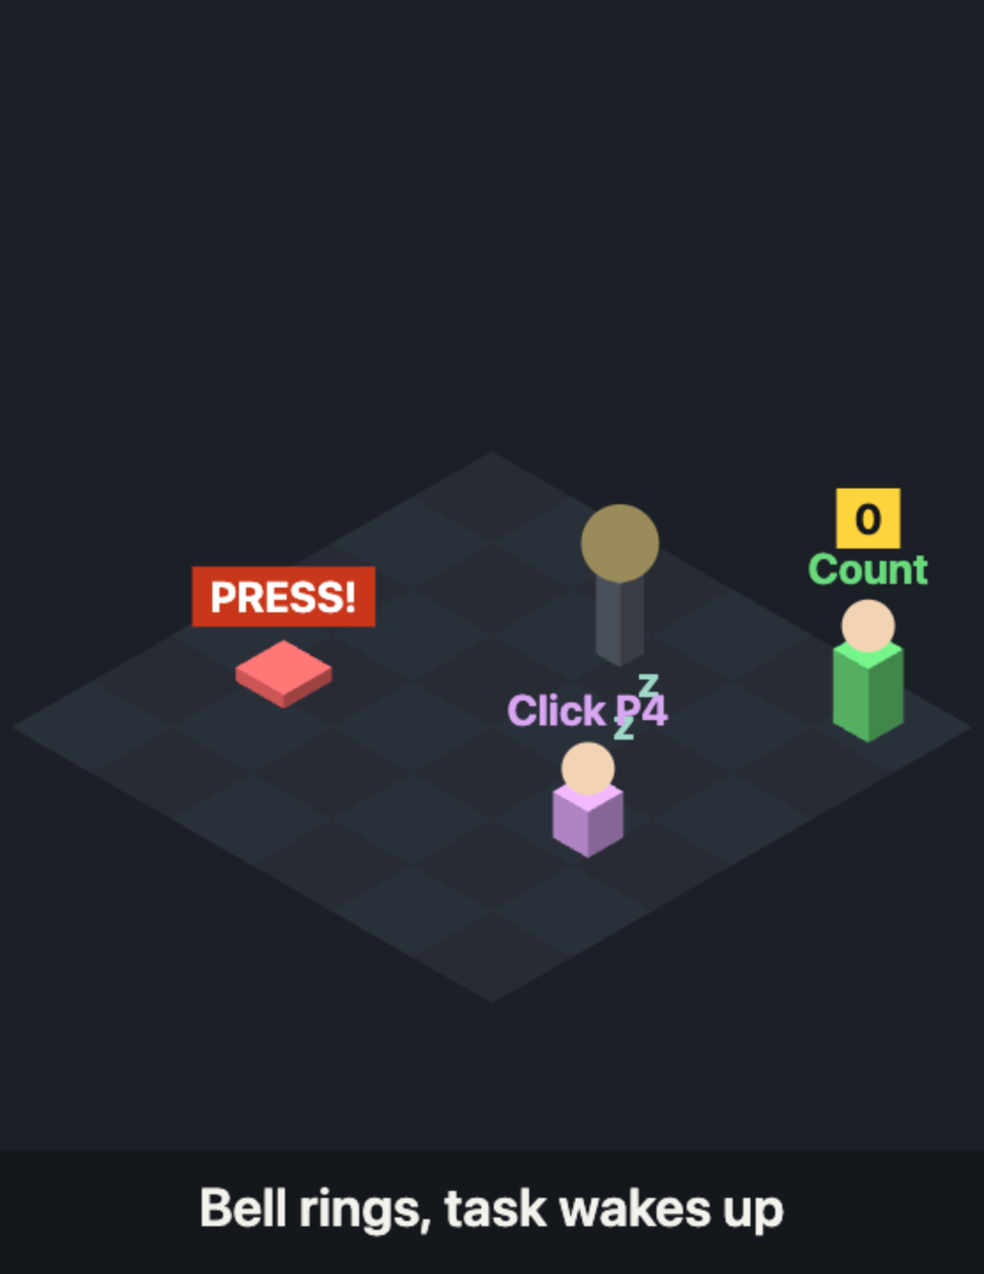
STEP 6
WANT
→
BUILD
→
CODE
→
RUN
→
PROBLEM
→
RTOS FIX
WHAT HAPPENS
BOOT pressed
ISR rings the bell
semaphore
clickTask prints
→
→
→
Every quick tap:
>>> CLICK!
instantly, while Count and Blink carry on
THE PROBLEM
Checking the button in a loop misses quick taps.
THE RTOS FIX
Let the hardware ring a bell: an interrupt wakes a task instantly.
attachInterrupt → xSemaphoreGiveFromISR → xSemaphoreTake
Exam words:
interrupt
ISR
binary semaphore
device driver
Notes:
STEP 6, RUN IT (about 7 minutes). Tap BOOT as fast as you can: every tap prints CLICK!, and counting and blinking carry on. Compare with Step 1, where taps were missed. THE PROBLEM: checking (“polling”) the button in a loop only sees it when the loop gets there. Quick taps slip through. THE RTOS FIX, the doorbell: you don’t open the door every minute to check; the bell tells you. The button press is an INTERRUPT: the hardware makes the CPU jump into a tiny function, the ISR (interrupt service routine). The ISR only rings the bell (gives a BINARY SEMAPHORE), like signing for a parcel at the door. clickTask, priority 4, wakes and does the real work, like unpacking the parcel later. ISR rules: tiny and fast, no delay(), no long printing, only ...FromISR() functions. The time from the press to the ISR starting is INTERRUPT LATENCY. DEVICE DRIVERS (2 minutes): code that hides hardware behind simple functions is a driver. In the Gaming Mouse, mpuReadAccel() is one: init the device, read its registers over I²C, convert the raw numbers, check for errors. Go back to the toolbox slide: all 12 functions used.

Slide 21
Four famous RTOS bugs
STEP 7 · BREAK IT ON PURPOSE
Starvation
Stack overflow
A busy task never sleeps, so the others never get a turn.
The task’s notepad is too small. The board crashes and reboots.
Fix: every task must sleep sometimes
Fix: give the task a bigger stack
Deadlock
Priority inversion
Each task holds what the other needs. Both wait forever.
A low task holds the key, so the high task is stuck waiting.
Fix: always take the keys in the same order
Fix: priority inheritance
Notes:
STEP 7, BREAK IT ON PURPOSE (about 11 minutes). Four bugs every RTOS developer meets. Show two live, act out two. STARVATION (live, the watchdog demo from the handout, type h): a high-priority task that never sleeps. The heartbeat task below it stops completely. After about 5 seconds the TASK WATCHDOG prints “Task watchdog got triggered”: a safety timer that checks the system is still healthy. Reset, type n: the same busy task with vTaskDelay(1) every 10 ms, and everything keeps running. Plain English: if one worker never takes a break, nobody else ever gets the desk. STACK OVERFLOW (live, the stack-crash demo, type s then c): each task’s notepad (stack) holds its local variables. Too small and it writes past the end: “stack overflow detected” or “Guru Meditation Error”, then a reboot. Joke: “It didn’t crash. It achieved enlightenment.” Fix: give more stack; measure with uxTaskGetStackHighWaterMark(NULL) and keep a margin. DEADLOCK (game, 2 volunteers): A holds the marker, B holds the duster. Rule: you need both to write, and you never let go of what you hold. Count down 3, 2, 1… nobody moves. Ask the room for the fix: always take the keys in the same order (marker first, then duster), or give up after a timeout. Exam: the four conditions are mutual exclusion, hold and wait, no preemption, circular wait. PRIORITY INVERSION (story): an ambulance (high priority) needs a one-lane bridge. A cyclist (low) is on it, holding the “key”. Cars (medium) keep overtaking the cyclist, so he never gets off, and the ambulance waits forever. Fix: PRIORITY INHERITANCE: give the cyclist a siren while he’s on the bridge, so nobody can overtake him. FreeRTOS mutexes do this automatically. Real story: Mars Pathfinder, 1997. The lander kept resetting on Mars because of exactly this. NASA fixed it from Earth by switching on priority inheritance.

Slide 22
Same mouse. Without RTOS vs with RTOS
FINAL PROJECT · THE GAMING MOUSE
Without RTOS
With RTOS
void loop() {
xTaskCreatePinnedToCore(sensorTask, …, 3, …);
blinkLED(); // 1000 ms
xTaskCreatePinnedToCore(cursorTask, …, 2, …);
readSensorAndMoveCursor();
xTaskCreatePinnedToCore(ledTask, …, 1, …);
}
void sensorTask(void *p) {
// the sensor waits while
for (;;) { read(); xQueueSend(…);
// the LED blinks with delay()
vTaskDelayUntil(&last, 10 ms); }
~1 update/s · the cursor jumps
~100 updates/s · the cursor glides
Same:
ESP32 + MPU-6050
sensor driver
maths
web page
Different: only how the jobs are run.
Notes:
THE FINAL PROJECT: the Gaming Mouse. Tilt the breadboard and the cursor moves on the web page (gaming-mouse.html in Chrome). Same wiring as Day 1. Both programs are ready-made in the student handout; nobody has to write them. LEFT, WITHOUT RTOS (GamingMouse_NoRTOS): exactly our Step 1. One loop does everything: it blinks the status LED with delay() for a whole second, and only then reads the sensor and moves the cursor. So the cursor gets about one update per second and jumps. RIGHT, WITH RTOS (GamingMouse_RTOS): exactly our Blink & Count. Three tasks with priorities: sensorTask (3, the most important, like Count), cursorTask (2, like Print), ledTask (1, like Blink). The sensor task wakes exactly every 10 ms with vTaskDelayUntil (Step 3) and sends each reading through a queue (Step 5) to the cursor task. A mutex protects the serial port (Step 4). About 100 updates per second: the cursor glides. BOTTOM: everything else is identical, the board, the sensor, the driver code, the maths and the web page. The only thing that changed is how the jobs are scheduled. That’s the whole point of an RTOS. Ask the room: “Which step of today is each line on the right?” Let them answer.

Slide 23
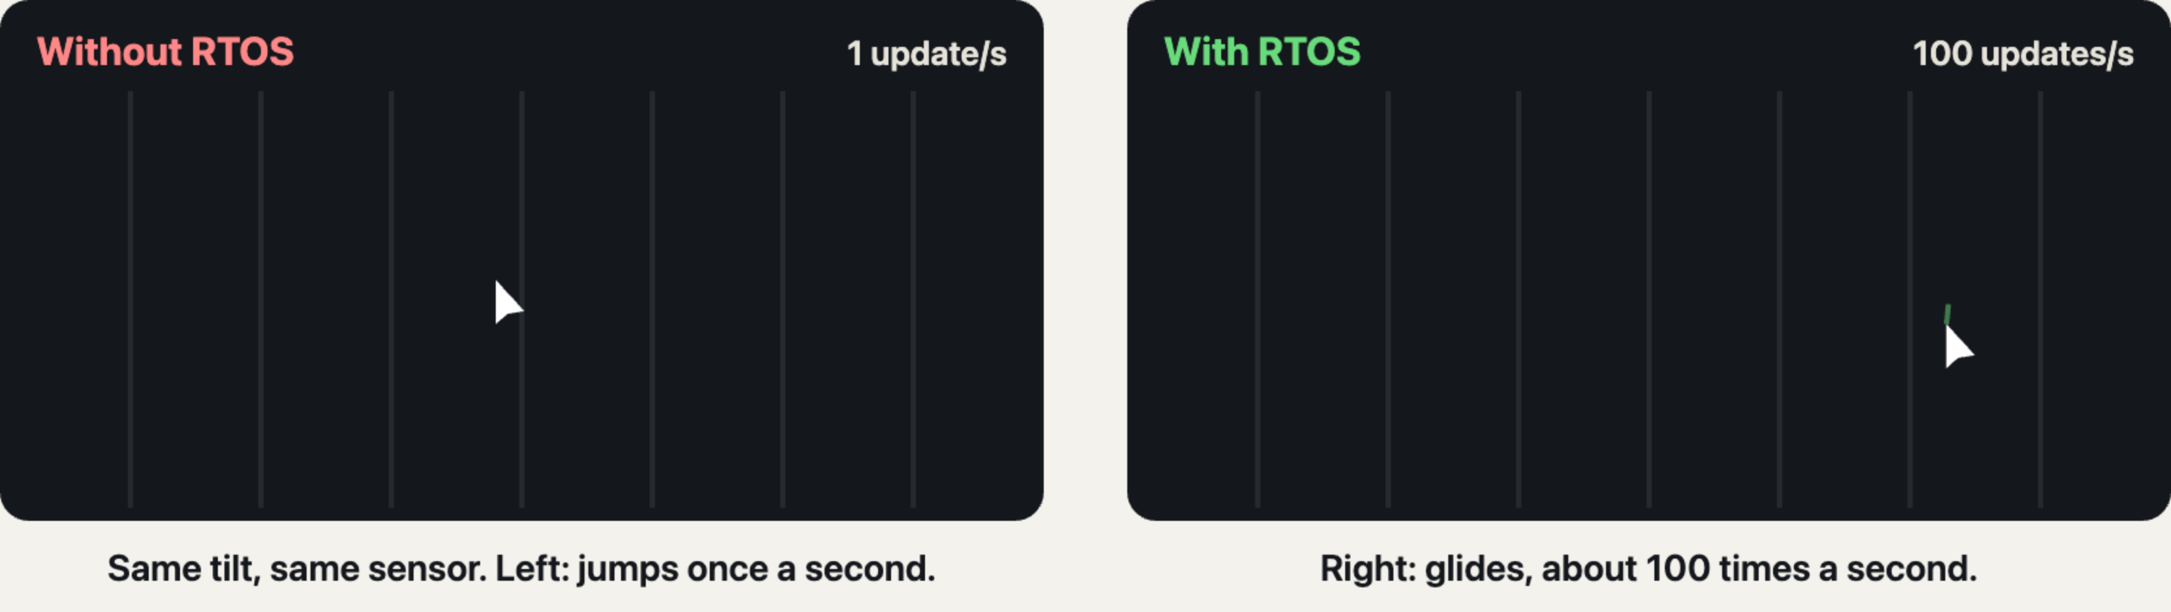
See the difference
FINAL PROJECT · LIVE DEMO
Demo:
1. Upload No-RTOS, tilt
→
2. Upload RTOS, tilt
→
3. Target challenge!
Notes:
LIVE DEMO (about 15 minutes), then everyone plays. 1. Upload GamingMouse_NoRTOS, open gaming-mouse.html in Chrome or Edge, click Connect board, tilt the breadboard. The cursor jumps about once a second, and the page’s counter shows about 1 message per second. 2. Upload GamingMouse_RTOS. Same board, same tilt. The cursor glides; the counter shows about 100 messages per second. 3. Everyone uploads the RTOS version and plays the target challenge: 10 targets, hold the cursor on each for one second. Fastest team wins. The animation on the slide shows the same difference in case the live demo misbehaves: left, the cursor only updates once a second and jumps; right, it updates about 100 times a second and glides. Say: “Two hours ago you wrote 10 lines of a super-loop. Now you can read every line of a real RTOS product.”

Slide 24

Promise kept. All five.
DAY 1 WE PROMISED 5 THINGS
01
RTOS, for real
tasks · priorities · mutex · queue · interrupts
02
A project that works
Blink & Count, and a real RTOS Gaming Mouse
03
Numericals, sorted
FCFS · SJF · Round Robin, straight from your syllabus
04
AI, used right
like an engineer, not a copy-paster
05
New friends
and a ridiculous amount of fun
Coding is dead. Engineering is the real flex.
Notes:
THE RECAP OF THE WHOLE WORKSHOP (about 4 minutes). This slide mirrors the “2 days, here’s what you walk out with” slide from the start of Day 1. Say: “Two days ago I promised you five things. Let’s check.” Read each line and ask the room: “Did we do it?” Let them answer yes before you move on. 01 RTOS, for real: not just the definition. You know what an RTOS is and why it exists (Day 1), and you used tasks, priorities, a mutex, a queue and an interrupt in your own code (today). 02 A project that works: you wired the ESP32 and the MPU-6050 (Day 1), built Blink & Count step by step, and ran a real RTOS Gaming Mouse, with and without an RTOS (today). 03 Numericals, sorted: FCFS, SJF and Round Robin, the scheduling problems from your EC syllabus, solved by hand. 04 AI, used right: remind them how we used AI in these two days, to explain, to check and to build faster, like an engineer who still understands every line, not a copy-paster. 05 New friends: the teams, the roleplays, the team race, the target challenge. Closing line, same as Day 1: “Coding is dead. Engineering is the real flex.” The serious version: writing code is getting cheap; understanding systems is the biggest opportunity of your generation, and you’ve just started. Optionally flash back to slide 1, the mind map: every branch is now done. Then ask for one-word feedback: what was the best part?

Slide 25
Love you guys ♥
All the best for your exams, and for everything you build next.
Coding is easy now. Engineering is the flex.
— Manish · RTOS Workshop, Day 2
Notes:
The last slide. Say thank you, and mean it: two days, a new topic, real hardware, and everyone built something. Optional: take a group photo with this slide on the screen. Remind them: the student handout has all the code and explanations, and the mind map is theirs to keep for revision before exams.

